Slide 1
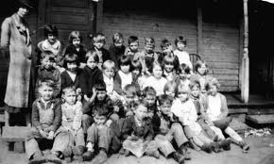
Children: chapters 10-18
By: Reanna Bourque

Slide 2
1800 Expansion
1826: Woman joined the American society so as to reduce the high consumption of alcohol in men, woman, and children
Drinking alcohol on a normal basis was accepted by society, leaving their children to grow up in a drunken society or to grow up with health problems due to alcohol

Slide 3
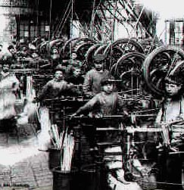
Industrial Revolution
huge demand for child labor
Child labor meant the employment of children for hard and tedious work
Children as young as 4 years old were employed in dangerous working conditions
Textile factories worked more than 12 hours a day
Worked in factories, as Miners, errand boys, chimney sweepers, sold cheap goods, in Mills, and even as Prostitutes
Many who worked in the mines developed lung cancer
Children’s work was usually seasonal, giving them some play time
Early 19th century parliament passed child labor laws à inspectors were appointed to make sure the law was obeyed
Gradually children were protected more and more by the law

Slide 4
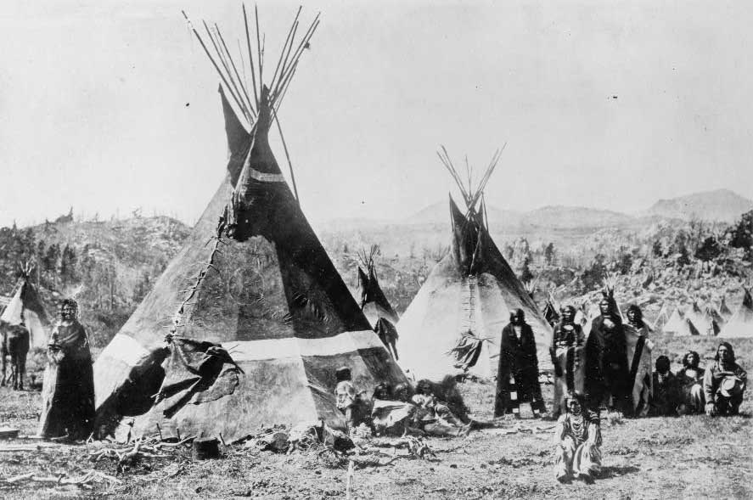
Indian Removal
Men, woman, and children were taken from their land and herded into make-shift forts
They were provided with minimal facilities and food
They were forced to march 1,000 miles

Slide 5
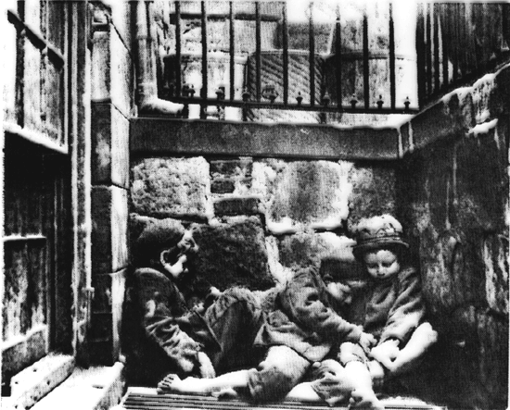
Panic of 1837
The depression put many out of work
Parents had no money and no food for the children
No money to pay the rent for them to live in their house

Slide 6
Plantation Life
The slave children were given jobs that included watching the infants or running errands
They carried water to adults working in the fields
Slave girls would learn household duties such as sowing and quietly serving tea
Young children of both races played together
Slave punishments, such as flogging, were extremely popular
The Cotton Gin made picking seeds more efficient and quick
The Cotton Gin took over the slave woman and children’s jobs of separating the seeds
As the cotton industry increased, the demand for slaves increased

Slide 7
Yeoman Farmers
Families tended to have 12-15 children
The children were needed to work the homestead
They lived crowded together in a 1 or 2-room log house
The children didn’t usually receive an education → some occasionally received a bit of an education if there was a local church-run school

Slide 8
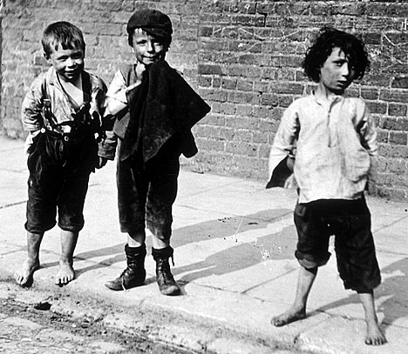
Poor White Children
Poorhouses were put in place to save the poor white children of immigrants from unfitness and poverty
Juvenile courts would put children in institutions or foster homes
Usually filled with poverty or neglect

Slide 9
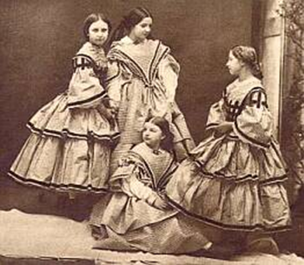
Middle Class
Middle class couples chose to have fewer children than in the past
Children required more care, training, and education → this placed higher demands on family resources
Birth rate decreased
Medical manuals suggested that couples end their sex life after they had reached the desired number of children
People commonly chose abstinence of infrequent intercourse
Surgical abortions became popular
¼ of every pregnancy was aborted
By 1860 → 20 states had outlawed the practice of abortion
Dangerous illegal abortions continued

Slide 10
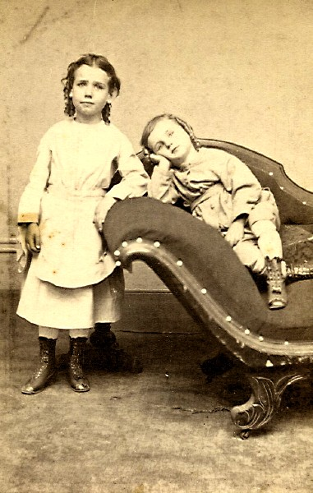
Child Rearing
Boys learned farming or craft skills from their father
Girls learned domestic skills from their mother
Children of the new middle class were nurtured in the beliefs and personal habits needed for success
Fathers made major decisions concerning the children
Mother’s Magazine → an association that woman formed to help raise their children to be religious and responsible
Middle class families sacrificed to keep their sons in school or in training for their chosen professions
Mothers made sure their children had friends and contacts that could potentially be useful when they were old enough to consider careers or marriage
Girls were trained to be silent, nurturing and supportive to help their husbands succeed

Slide 11
Vocabulary 1
Cotton Gin: a machine for separating the fibers of cotton from the seeds
Yeoman: one of a class of lesser freeholders who cultivated their own land, early admitted in England to political rights
Depression: a period during which business and employment decline severely or remain at a very low level of activity
Abortion: any of various surgical methods fro terminating a pregnancy (during the first 6 months)
Flogging: to beat with a whip, stick, etc. as punishment

Slide 12
Quiz 1
1.) During 1826, woman joined the American Society to…
A) Help build railroads
B) Reduce the high consumption of alcohol so that children didn’t grow up in a drunken society
C) Support alcoholics
D) Start a mass rebellion
2.) TRUE or FALSE, Andrew Jackson had 4 children?
3.) Textile factories worked…?
A) 1 hour a day
B) 6 hours a day
C) More than 12 hours a day
D) Less than 30 min a day

Slide 13
Quiz 1
4.) TRUE or FALSE, children were employed in dangerous working conditions?
5.) The cotton gin was all of these EXCEPT for…
A) Used by George Washington
B) Made by Eli Whitney
C) Speeded the process of what 100 slaves could do in a day in 1 hour
D) A machine that increased the need for slaves
6.) TRUE or FALSE, Yeoman families tended to have 1 or 2 children maximum?
7.) Yeoman children tended to …
A) Have a very extensive education
B) Not be associated with the local church of any sort
C) Lived in massive mansions
D) Lived with 12 or 15 of their siblings in a 2-room log house

Slide 14
Quiz 1
8.) TRUE or FALSE, poorhouses were put in place to help house the upper class people?
9.) TRUE or FALSE, middle class couples wanted to have only a few children?
10.) Which of these is Incorrect?
A) Abortion became a very popular but illegal practice
B) Mothers made all decisions concerning the children
C) Children were raised to be religious and responsible
D) Girls were trained to be silent in order to be supportive of their husbands

Slide 15
Quiz 1 Answer’s
1.) B
2.) False
3.) C
4.) True
5.) A
6.) False
7.) D
8.) False
9.) True
10.) B

Slide 16
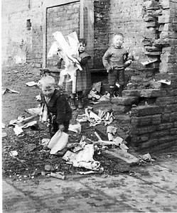
Preindustrial City
Huge demand for female and child labor
Children as young as 5 worked underground
Gradually children were protected more by the law
sanitation
Children drank water from wells contaminated by outdoor privies
Children were more susceptible to diseases such as yellow fever, cholera, and typhus

Slide 17
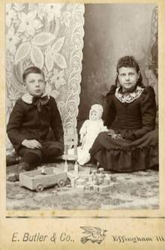
Class Structure
19th century children were always dressed like little adults
Reformers believed that children could be molded
Middle class girls played with wood and porcelain dolls
Middle class boys played with marbles and toy soldiers
Poor children had to often make their own toys

Slide 18
Education
Girls from upper class families were taught by a governess
Middle class girls went to private school
Middle class boys were often sent to public schools
Churches provided schools for poor children
There were also dame schools → they were run by woman who taught a little reading, writing, and arithmetic
Discipline was brutal and beatings were common (canes were used)
Children who weren’t bright at lessons were humiliated by being forced to wear a cap with the word ‘Dunce’ on it

Slide 19
Prison reforms
Men, woman, and children were thrown together in the most repulsive conditions
During 1812, reformers from Boston and New York removed the children from jails into juvenile detention centers
Dorthea Dix promoted the reduction of beating and whipping, and the separation of woman, children, and the sick

Slide 20
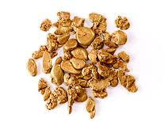
Gold Rush
Children were scarce in the Gold Rush settlements
Fathers would send gold nuggets as gifts to their children
Even more rare were the birth of children among the settlements
Any settlement that had more than a few children managed to provide a school for them to attend

Slide 21
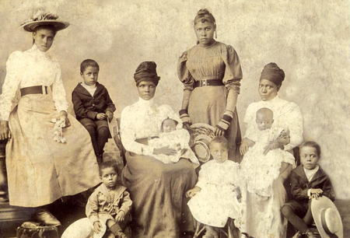
Underground Railroad/Free Slave’s
A slave who ran away and made it through to the safety of the North would recoup in the ’Underground Railroad’ then would usually go back to help their spouse’s, children, and/or friends escape
Harriet Tubman went back 13 times
White families would be awakened at night by a ‘signal’ (a gentle knock at the door)
They would open up their doors in the cold or rain to find a 2-horse wagon loaded with fugitives, the majority being woman and children
A majority of African American children lived in a household of only one parent (usually the mother)
Older family members passed on traditions orally to the children

Slide 22
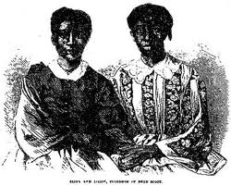
Dred Scott
Dred Scott married Harriet Robinson and had 2 children, Eliza and Lizzie
When his owner John Emerson died, Mrs. Emerson sent Dred Scott and his children away to work for other families
Temperance/Anti-Drink
Woman did not want their children to grow up in a drunken society or to grow up with health problems due to alcohol

Slide 23
Vocabulary 2
Reform: the improvement or amendment of what is wrong, corrupt, or unsatisfactory
Juvenile: pertaining to or characteristic or young persons; youthful
Settlement: a small community, village, or group of houses in a thinly populated area
Fugitive: having taken flight, or run away
Temperance: habitual moderation in the indulgence of alcoholic liquors

Slide 24
Quiz 2
1.) Children who worked underground were
A) 32 years and older
B) 5 years old and older
C) 13 years old and older
D) 18 years and older
2.) Was school mandatory?
A) Yes, but school was not free to attend
B) No, but families enjoyed paying what little money the schools
C) Yes, everyone believed it to be unnecessary so the attendance rate was always very low
D) No, and no one wanted to pay the extra fee for their child anyways
3.) Were 19th century children beaten during school?
A) Only a tiny pat on the back of their hands
B) No, and if teachers were caught they were sued for child neglect and sent to the state asylum for the remainder of their lives
C) When caught doing wrong, teachers would enforce that they all circle up and sing Chum-Bye-Ya
D) Yes, children were beaten with canes and humiliated all throughout their schooling

Slide 25
Quiz 2
4.) 19th century middle class girls…?
A) Played with wood or porcelain dolls
B) Went to private school
C) Always were dressed in adult woman fashion
D.) all of the above
5.) What eventually happened to children unfortunate enough to be forced to endure time in prison/asylums?
A) The guards gave them a never ending supply of oatmeal and soggy bread
B) They were brought out so that all the people in the towns could dance around them and throw grapes at them
C) A woman named Dorthea Dix reformed the prisons so that a juvenile correction center could be set up for children persecuted by the law
D) Nothing happened, everyone let them endure the horrid, repulsive conditions
6.) Were children numerous during the Gold Rush?
A) Yes, there were bountiful amounts of them running around throwing gold nuggets at the diggers
B) No, children were scarce and rarely seen in the first gold rush settlements
C) There wasn’t an overly amount of children, but there wasn’t a scarce amount either

Slide 26
Quiz 2
7.) What is a run-away slave called?
A) llama
B) Evangelist
C) Fugitive
D) Inauguration
8.) What is the Underground Railroad?
A) Secret society of whites in the north that took in runaway slaves and fed and clothed them and hid them from any trackers
B) A series of trains that secretly transported goods all over the country
C) A train filled with teenagers holding water balloons that would throw them at innocent passer Byers
D) A secret society of African Americans that would take in white slaves and keep them safe from anyone tracking them

Slide 27
Quiz 2
9.) What was the majority of fugitives loaded in wagons that would pass through to the Underground Railroad?
A) White men
B) Only 90 year old uncles
C) Stray goats and chickens
D) Woman and children
10.) How were traditions passed on?
A) Through long and complicated telegrams to distant relatives
B) They were passed on via messages in a bottle, in the hopes that their messages would reach the rightful ancestor
C) Orally to the children
D) Morse code was very popular during the 19th century among African Americans; this was in order to pass traditions in an orderly fashion

Slide 28
Quiz 2 Answer’s
1.) B
2.) A
3.) D
4.) D
5.) C
6.) B
7.) C
8.) A
9.) D
10.) C

Slide 29
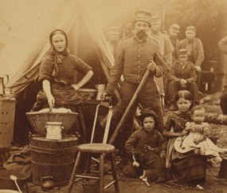
Civil War
More than 300 northern soldiers were under the age of 13
A few were under the age of 10 years old
Many lied about their ages and used fake identities so they could join the war
Children thought fighting in the civil war seemed like a glamorous adventure
Many of the boys became drummer boys, their job was to lead the marching troops into battle, many were killed because they were in the lead
A boy named Albert Munson was 15 years old when he joined the 23rd Massachusetts with his father. During the battle of Roanoke Island, his father was wounded. Albert decided to continue to drum using a pistol for a drum stick. Albert marched right up to the enemy, but was shot and killed.
Children would help the wounded by changing their bandages, giving them water, and changing their beds
Children were also spies, they collected valuable information: the enemy talked as unsuspecting children listened and watched close by

Slide 30
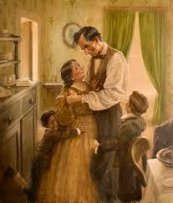
Lincoln’s children
Andrew Johnson’s children
The schools task was to raise republican children
Lincolns children lived in the white house during the most dramatic years in our presidential history
Robert Todd Lincoln was the only Lincoln to live to full maturity
Martha Johnson Patterson (1828-1902)
Charles Johnson (1830-1863) → suffered from Alcoholism
Mary Johnson Stover Brown (1832-1883)
Robert Johnson (1834-1869) → committed suicide due to alcoholism
Andrew Johnson Jr. (1852-1879) → promised to never touch liquor

Slide 31
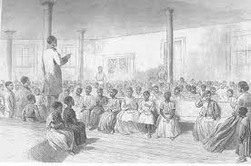
Slave/African American education
Once a slave was bought, all of their children would be born into slavery
During the civil war, the prospect of children buying their freedom lowered considerably
Rapid spread of schools → many schools for African American’s flourished after the Civil War as African Americans quickly moved to educate themselves and their children

Slide 32
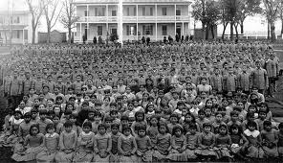
Native American
Children
November 29, 1864 → 700 drunk men slaughtered 105 Cheyenne woman and children while their leader Black Kettle and his men were out hunting
Organizations were put into action to change tribal customs
Children’s hair were trimmed short
The children were placed in boarding schools where they were removed form their parents influence of traditional values and practices
Indian children fled most white schools because they were treated as savages

Slide 33
Cowgirls and Prostitutes
The wives of cattlemen would normally carry their babies and small children while they rode sidesaddle over enormous distances
The majority of woman cared for the children and other domestic chores
Their daughters were able to enjoy more freedom à they could ride clothespin style
Some children worked as prostitutes

Slide 34
Vocabulary 3
Civil War: a war between political regions within the same country
Child Labor: the full time employment of children who are under the minimum legal age
Domestic: pertaining to the home, the household, household affairs, or the family
Savages: an uncivilized human being
Boarding Schools: a school at which the pupils receive lodging during the school term

Slide 35
Quiz 3
1.) How were children able to join the civil war?
A) They screamed and cried
B) They used fake identities and names
C) They handed them impressive résumé’s with all of their previous jobs listed
D) They wore stilts under their clothes and put on fake beards to make themselves appear older
2.) What job did young boys obtain once they joined the civil war?
A) Drummer boys
B) They were spies
C) They helped the wounded by changing their bandages and beds
D) All of the above
3.) What problem did Andrew Johnson’s children have?
A) Couple of his children suffered from alcoholism
B) His children didn’t have a problem
C) They were always very hyper due to their obsession with coffee
D) His children workaholics

Slide 36
Quiz 3
4.) Once a slave was bought…..?
A) The slave was freed immediately
B) All of their children were born into slavery
C) The first born would remain a slave and the rest of the other children would be free
D) The parent would remain of a slave for the rest of their life, but all of their children would be free
5.) Why were Indian children placed in boarding schools?
A) They expressed immense interest in it
B) Their parents didn’t want them around
C) So that they could be removed from their parents influence of traditional values and customs
D) They didn’t want to be near their parents anymore
6.) What did children think of the Civil War?
A) That it was glorious adventure
B) It was brutal and unnecessary
C) That only their parents should fight
D) That only ninnies and little girls would fight in the Civil War

Slide 37
Quiz 3
7.) Why did Indian children flee most white schools?
A) They were treated like savages
B) They were accustomed to the extreme hospitality and respect
C) So that they could bring their parents to their Open House
D) None of them fled, a rumor was spread throughout the schools
8.) What did the wives of cattlemen do with their children when they rode sidesaddle over great distances?
A) They gave their children up for adoption so they didn’t have to carry them
B) They would carry them halfway and then leave them near a shady cactus plant
C) The parents would fasten a make-shift sled to the back of their horses with their babies and children would sit comfortably on top
D) They carried their babies on their laps
9.) How old was the average child-soldier?
A) About 4 years old
B) Toddler
C) 10-13 years old
D) 9-10 months old
10.) Once the Civil War ended, did African American education flourish?
A) No, not even a little bit
B) Yes, it flourished very rapidly
C) It did for a year, but then was slowly over powered by white children because their need for education was so high
D) It flourished quickly, but then was quickly stopped a month later by white authorities

Slide 38
Quiz 3 Answer’s
1.) B
2.) D
3.) A
4.) B
5.) C
6.) A
7.) A
8.) D
9.) C
10.) B

Slide 39
Citation
Bibliographic Citation to highlight & copy
lambert, T. (n.d.). children in the 19th century. Retrieved from http://www.localhistories.org/19thcenturychildren.html In-Text Citation to highlight & copy
(lambert) There are usually many variations of in-text citations.
Bibliographic Citation to highlight & copy
gold rush stories: children of the gold rush. (1999). Retrieved from http://www.library.state.ak.us/goldrush/stories/children.htm In-Text Citation to highlight & copy
("gold rush stories:," 1999) There are usually many variations of in-text citations.
children in the civil war. (n.d.).
http://library.thinkquest.org/06aug/01591/children-t.html
children and the civil war: the role of children in the war. (n.d.).
http://www.brunswick.k12.me.us/lon/civilwar/children/essays.html
Out of Many text book
Notes

